Slide 1
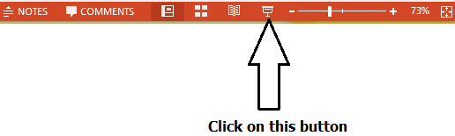
Function calling in Assembly
Syeda Farwa Batool

Slide 2
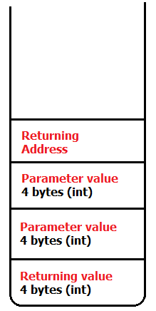
Function Calling in C++
int sum(int a , int b)
{
int c = a + b;
return c;
}
int main()
{
int a = 10;
int b = 20;
int c = sum(a,b);
cout << c;
}
What happed at this line

Slide 3
Function calling in Assembly
In Assembly you have to perform each step by yourself.
There is stack in assembly which resides in SS (Stack segment) and pointed by SP(Stack pointer)

Slide 4
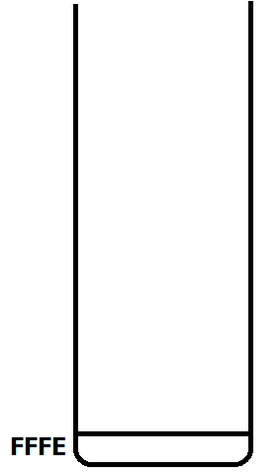



MOV AX,5
Initially SP points at FFFE
push ax (this value should be 16 bit)
Value of ax will be placed at SS:SP-2
Current value of SP = FFFC,
Value of SS:SP is 5
pop cx (this value should be 16 bit)
Value of cx is 5
Current value of SP = FFFE,

Slide 5
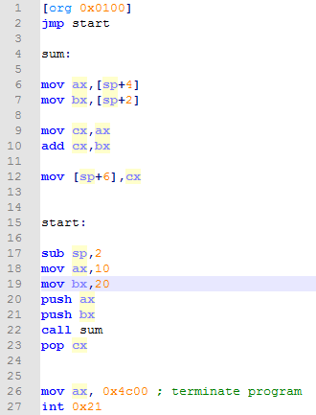
Error at these lines, we can not de-refer sp (stack pointer)

Slide 6
